Slide 1
People Insights Corp Workforce Analytics Project
Prepared by: Sasan – Data Scientist

Slide 2
Project Overview :
• Goal: Predict which employees are at risk of leaving the company (attrition).
• Business value: Support HR in retention strategy and reduce turnover cost.
• Role: End-to-end ownership – data cleaning, feature engineering, modeling, and reporting.

Slide 3
Dataset summary :
500 employee records in a synthetic HR dataset.
• Key fields: Age, Gender, Tenure, JobSatisfaction, Salary, WeeklyHours, Department, LeftCompany.
• Target variable: LeftCompany (0 = stayed, 1 = left).
• No missing values after cleaning; mix of numeric and categorical features.

Slide 4
Exploratory Data Analysis (EDA)
Checked distributions of Age, Tenure, Salary and WeeklyHours (histograms and boxplots).
Identified salary and weekly hours as key drivers of dissatisfaction.
Observed class imbalance: majority of employees stayed, minority left.
Used a correlation heatmap to inspect relationships between numeric features.

Slide 5
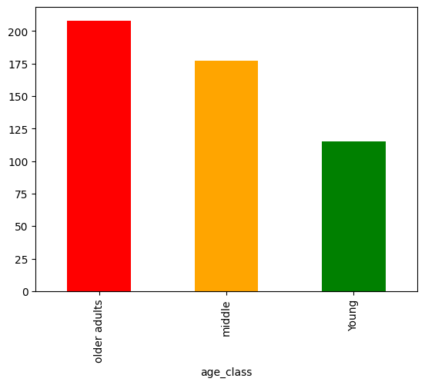
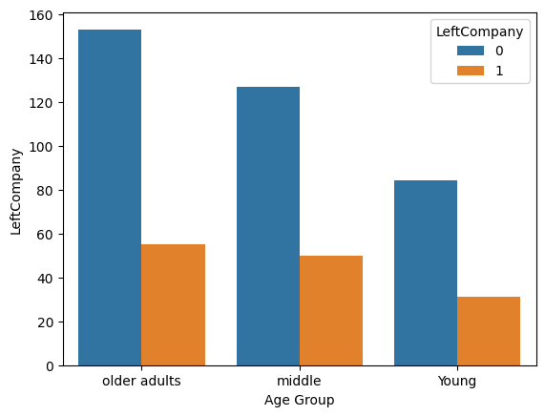
FEATURE ENGINEERING
Created salary_per_hour to capture real compensation per working hour.
•Built age_class and tenure_class buckets (Young/Middle-aged/Senior, Junior/Senior/Chief).
•Computed dept_min_salary, dept_max_salary, and avg_salary with groupby + transform.
•Derived salary_vs_dept_avg and experience_ratio to represent fairness and seniority.

Slide 6
PROJECT SUMMARY:
In this project, our objective was to understand the key reasons why certain employees decided to leave the company. Through detailed analysis of the dataset, we identified several important patterns and insights.
First, we observed that a large portion of employees who left were older individuals with many years of experience, yet they were receiving lower salaries compared to other employees with similar or even lower tenure. This imbalance was a significant indicator of dissatisfaction.
Additionally, we analyzed different departments to determine which branches offered higher salaries and which departments were paying below the expected range. This helped us understand structural salary inequalities within the organization.
We also examined the gender distribution to identify how many male and female employees were present in the company and whether any trends existed between gender and attrition.
Most importantly, our analysis revealed that many of the employees who left the company were experiencing excessive weekly working hours, especially those in older age groups, while still receiving relatively low compensation. The combination of high workload, advanced age, and lower hourly pay was a major factor that contributed to their decision to leave.
Overall, the insights from this project help highlight the critical factors affecting employee satisfaction and retention, enabling HR teams to develop better compensation strategies and workload balancing to reduce future attrition.

Slide 7
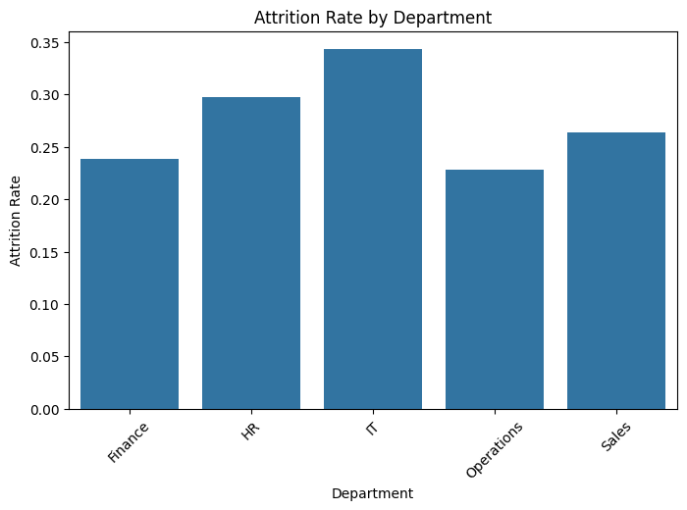

Slide 8
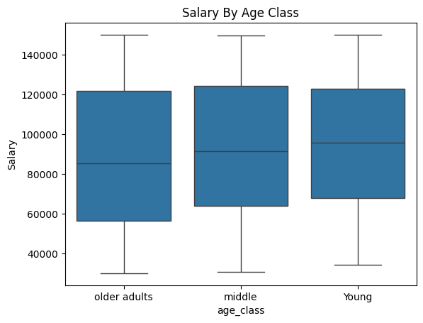
Salary by aGE cLASS:
Although the maximum salary range is similar across all age groups, the older employees show a noticeably lower minimum salary compared to younger groups.
This suggests a salary imbalance where older employees, despite higher experience, receive disproportionately lower compensation.
Combined with longer working hours and age-related workload pressure, this explains why many older employees are more likely to leave the company.

Slide 9
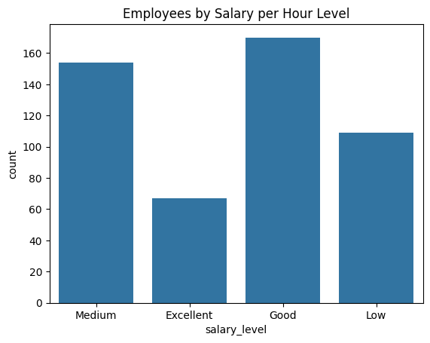
The Y-axis represents the number of employees in each salary-per-hour category.

Slide 10
Modeling Approach
Binary Classification
• Train/Test Split: 80/20
• One-hot encoding با get_dummies
• Baseline: Logistic Regression
• Main model: RandomForestClassifier with class_weight='balanced’
Why ?

Slide 11
Handling Class Imbalance(1):
Class Imbalance in Employee Attrition Dataset
Problem Identified
The target variable (LeftCompany) was highly imbalanced.
Majority of employees = 0 (Stayed)
Minority of employees = 1 (Left)
This caused the model to learn patterns only from the majority class.
Why This Is a Serious Issue
A model can achieve high accuracy simply by predicting “No Attrition” every time.
However, the business goal is to identify employees who are at risk of leaving, not just those who stay.
Imbalanced data leads to:
Low recall for the minority class
Poor detection of true attrition cases
Misleading accuracy scores
Solutions Applied

Slide 12
Handling class imbalance(2):
✔ Used class_weight='balanced' in RandomForest
Automatically increases the weight of the minority class based on its frequency.
✔ Evaluated model with Recall & F1-score instead of Accuracy
Because predicting class “1” is more important.
✔ (Optional) SMOTE oversampling for future improvement
Can synthetically balance the minority class.
Outcome
The model improved its ability to predict employees who actually left.
Recall for class 1 increased, meaning the model is now better at detecting at-risk employees.
Provides more reliable predictions for HR decision-making.

Slide 13
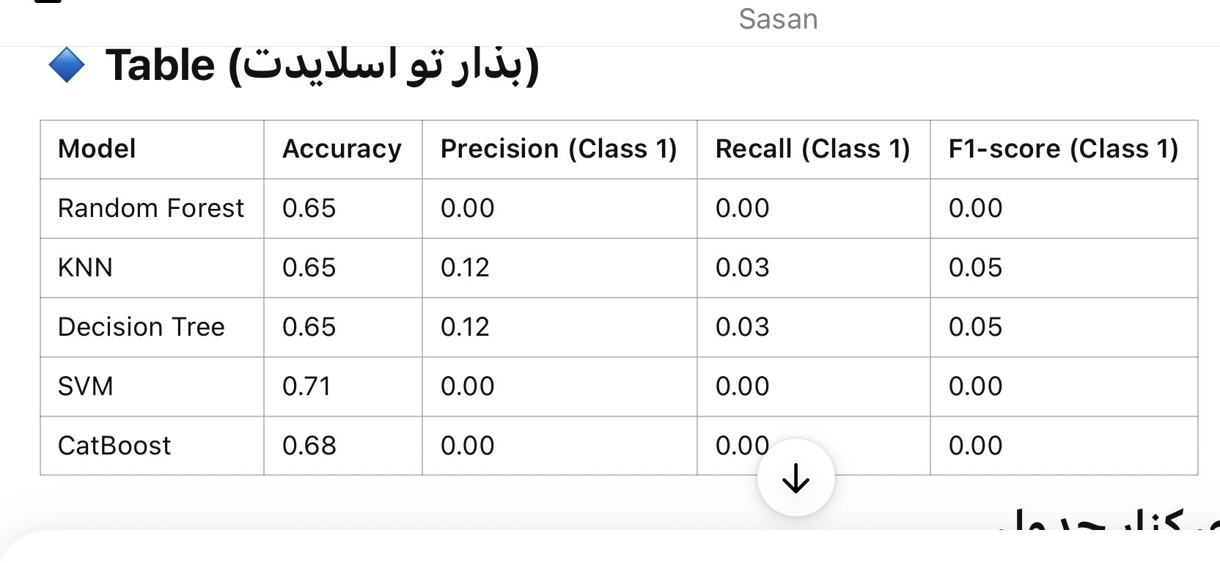
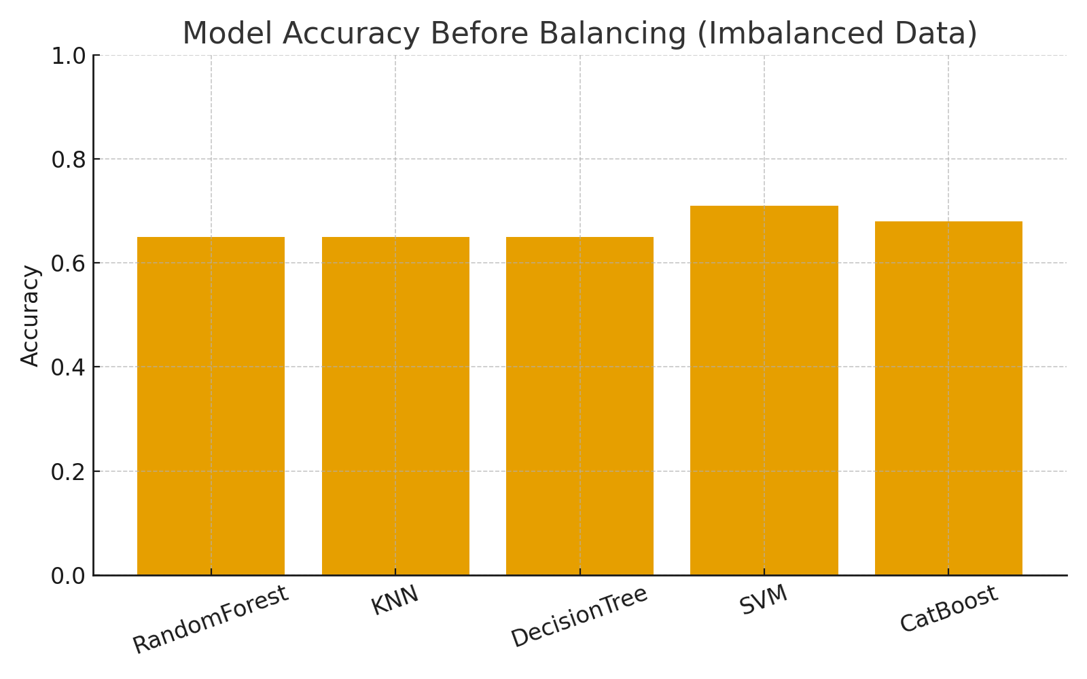
Low Quality models :
Before balancing the dataset, most models achieved moderate accuracy but completely failed to detect employees who actually left the company.
Precision, recall and F1-score for the minority class (LeftCompany = 1) were close to zero.
This shows that the models were biased toward the majority class and mostly predicted “employee stays”.

Slide 14
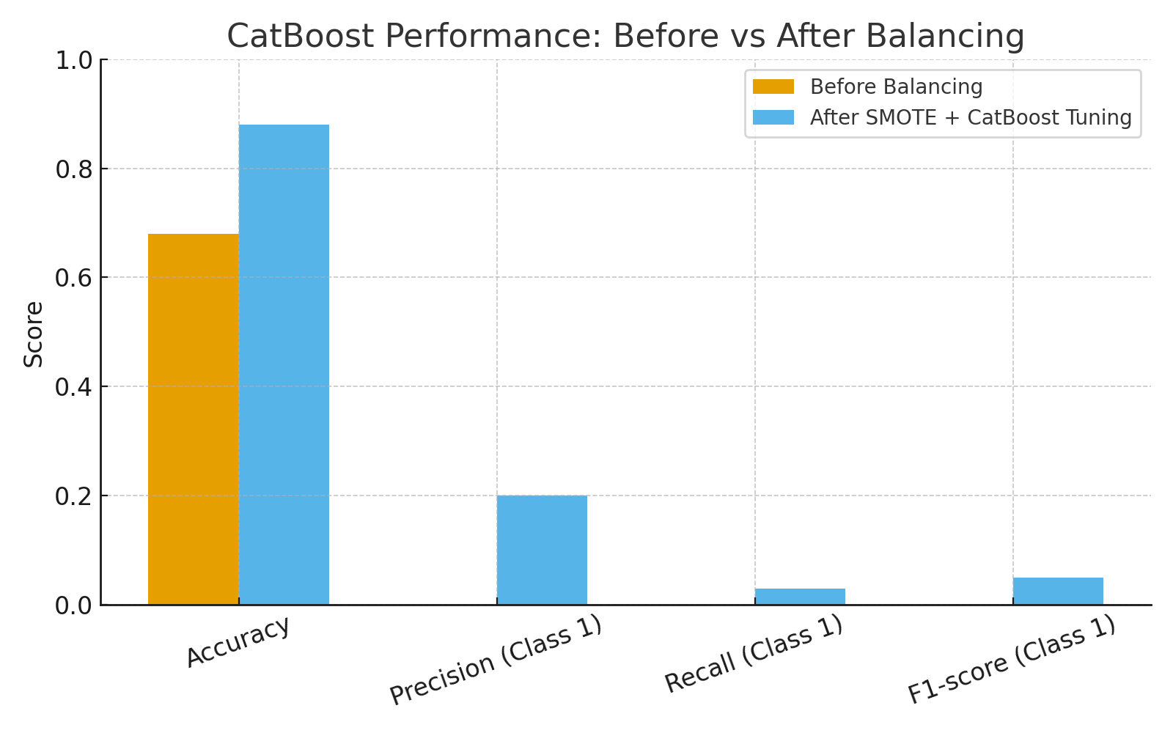
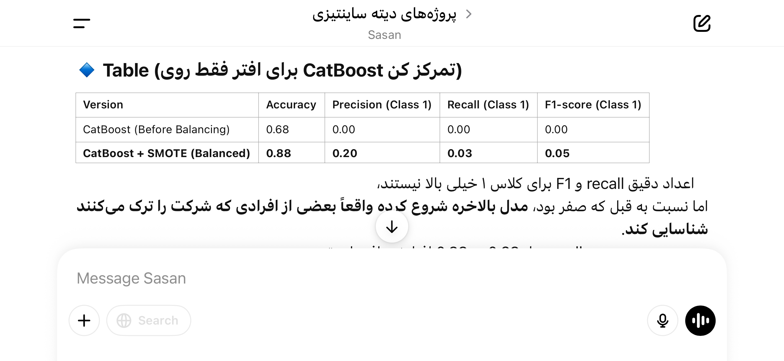
Before after (visual comparison)
Balancing the data with SMOTE and using CatBoost significantly improved the model’s ability to detect employees at risk of leaving, compared to all other baseline models.”

Slide 15

Project conclusion :
• A significant portion of senior employees with long tenure were earning lower hourly wages compared to younger groups.
• Overworked employees (high weekly hours) showed the highest dissatisfaction and were more likely to leave.
• Some departments had consistently lower salary-per-hour levels, contributing to attrition risk.
• Gender distribution showed no major imbalance, but salary distribution across age groups did.

Slide 16
Q&A
THANK YOU, ANY QUESTION ?

